Slide 1

Valley Crossroads
Seventh-Day Adventist Church
Recreation Room Accessory to (E) Church
11350 Glenoaks Blvd,
Pacoima, CA 91331

Slide 2
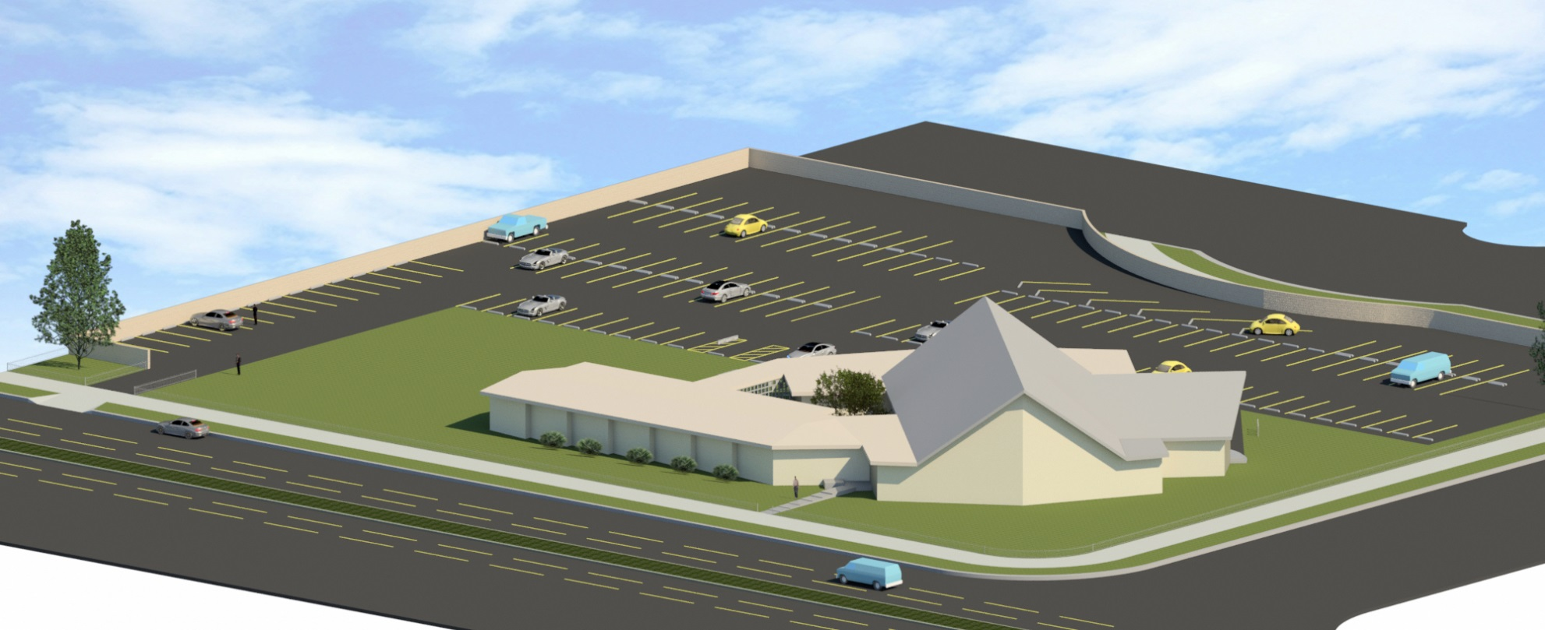
Valley Crossroads Seventh-day Adventist Church
Existing Church (Bird’s-Eye View)

Slide 3
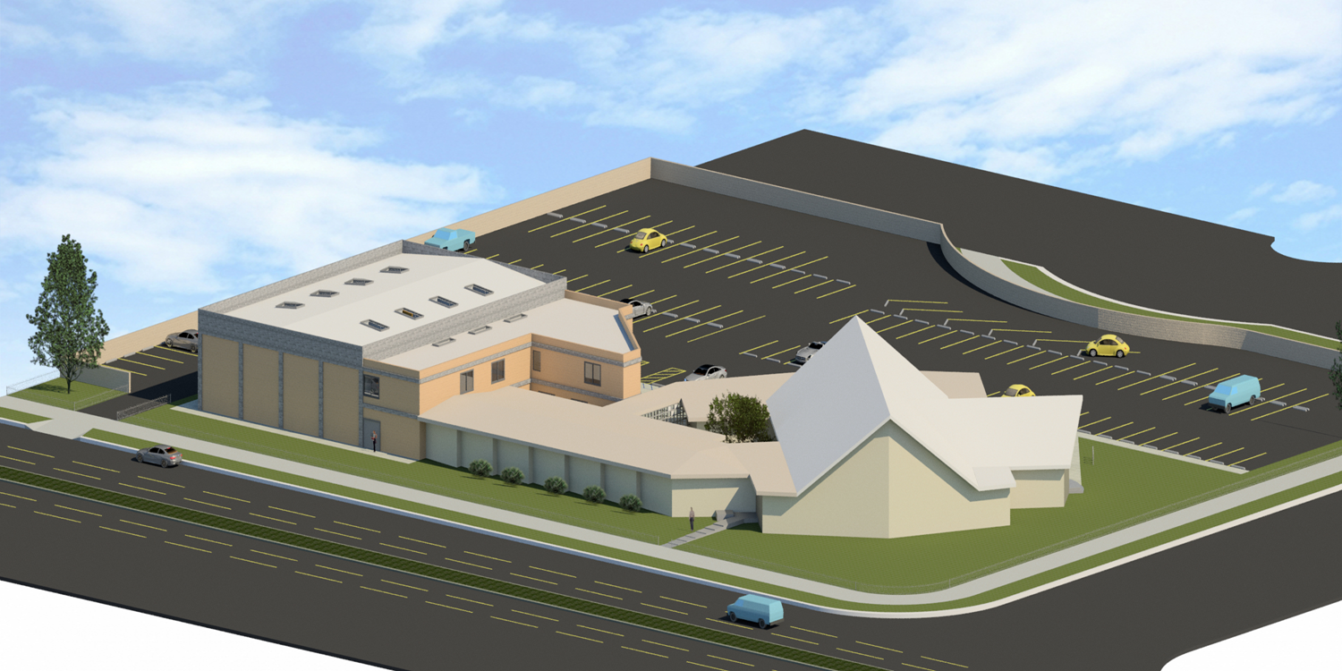
Recreation Center and Bathrooms
(Glenoaks View)

Slide 4
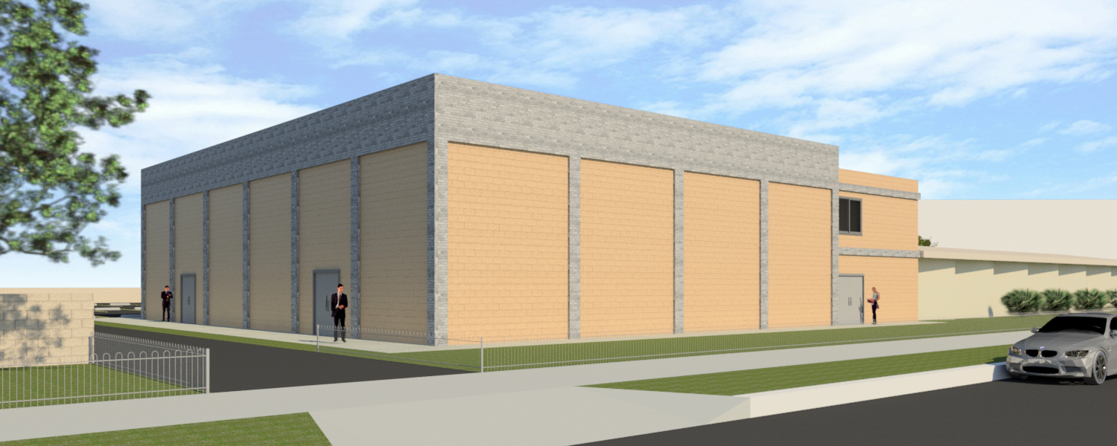
Recreation Center and Bathrooms
(Driveway View)

Slide 5
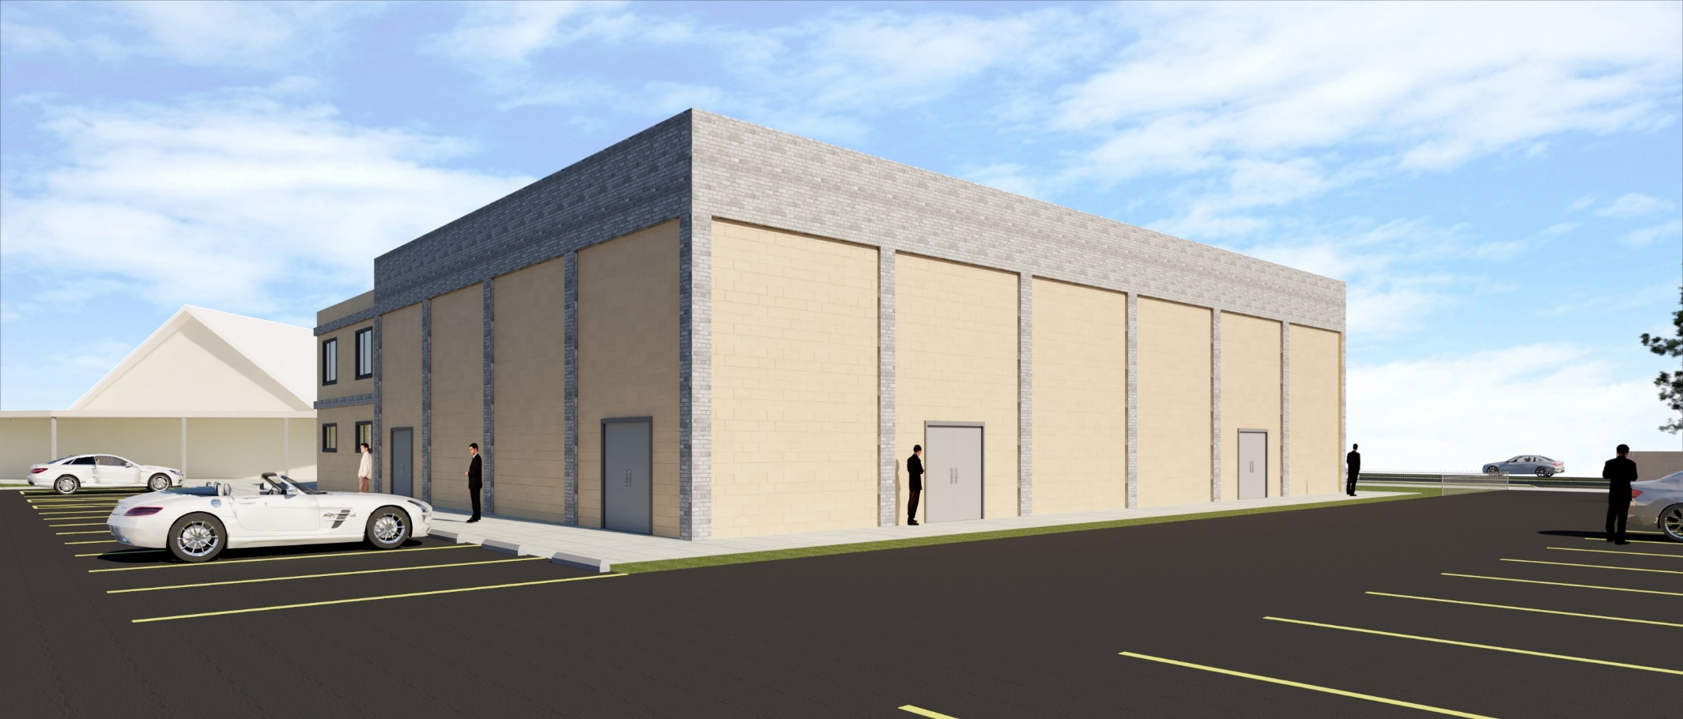
Recreation Center and Bathrooms
(Parking View)

Slide 6
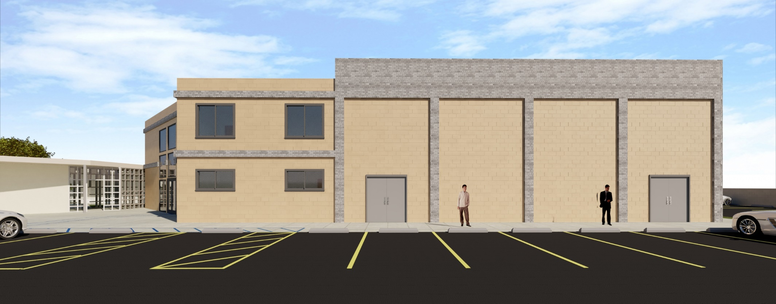
Recreation Center and Bathrooms
(Rear View)

Slide 7
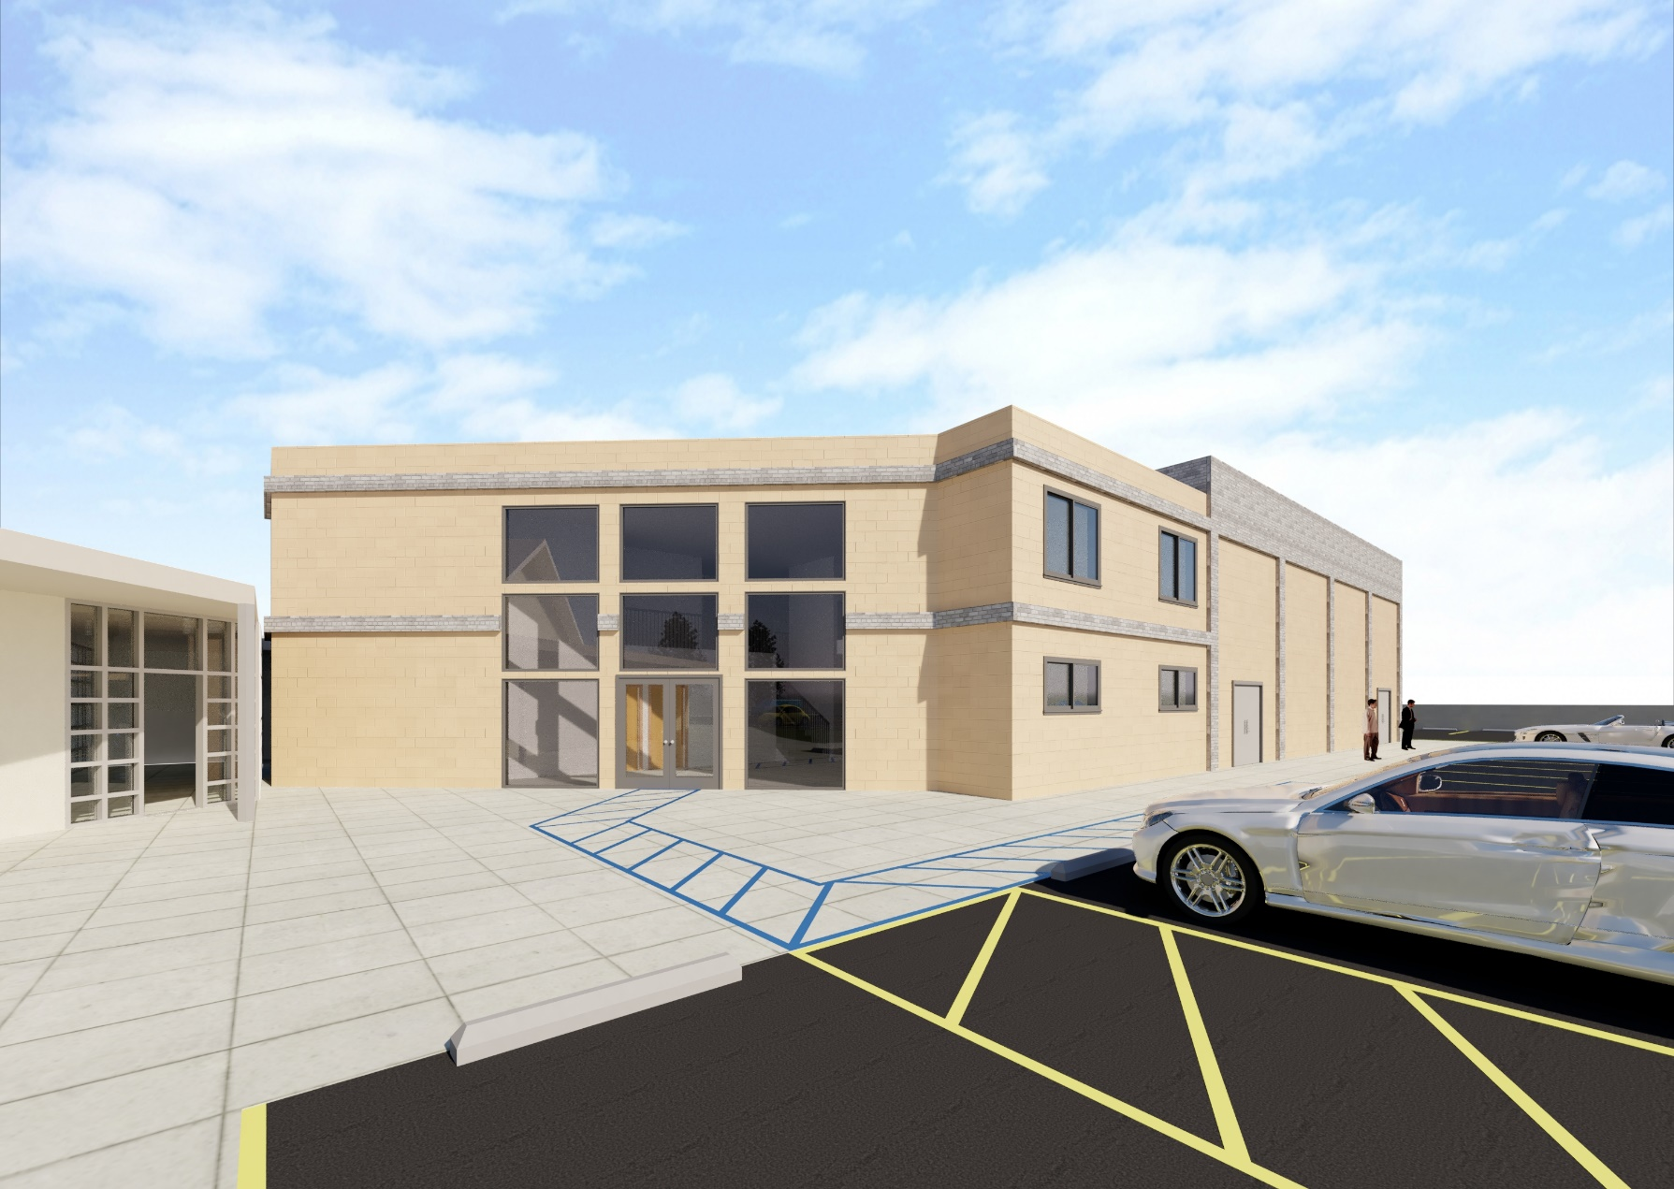
Recreation Center and Bathrooms
(Entry Way)

Slide 8
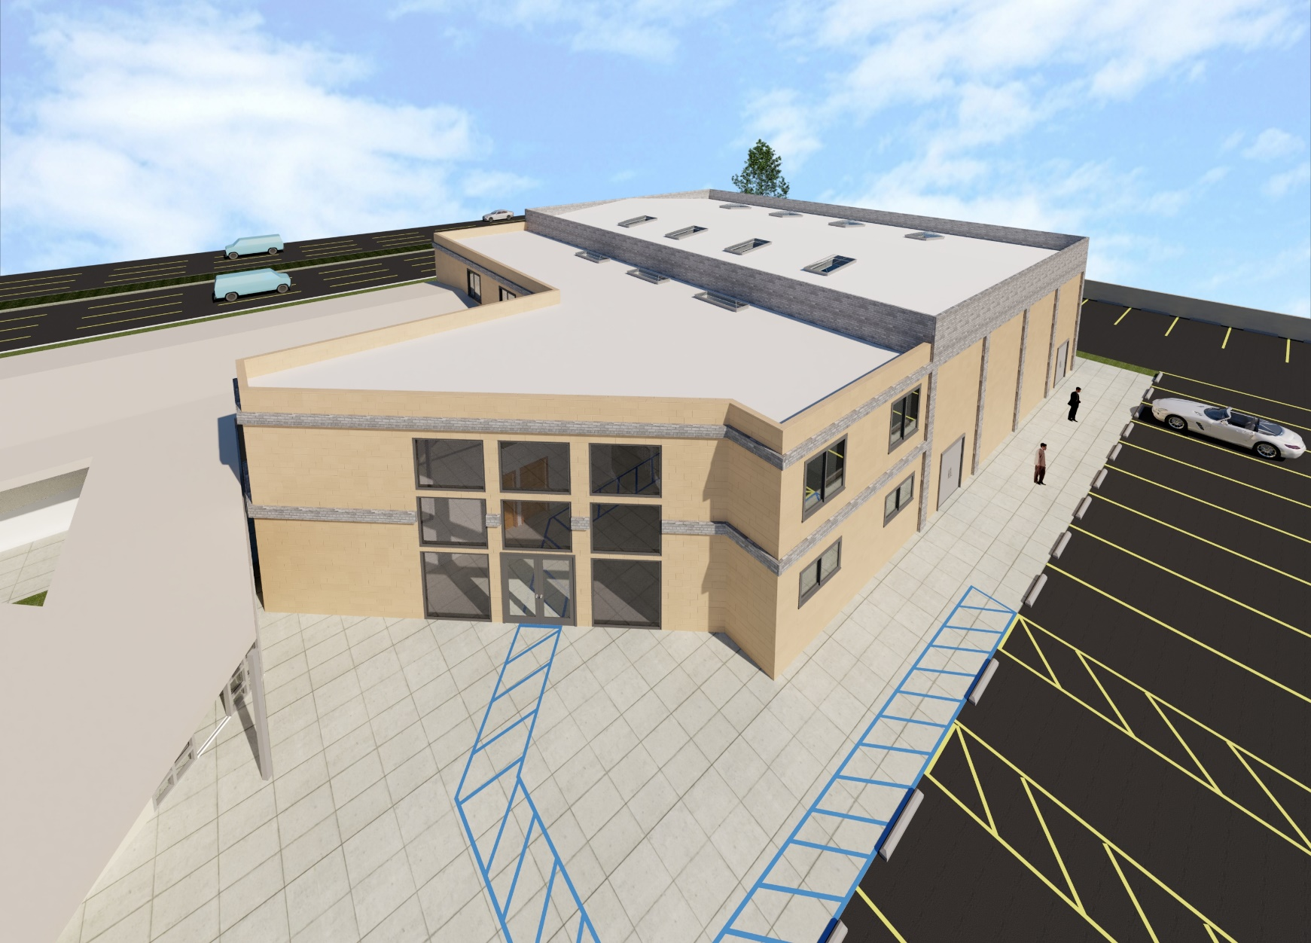
Recreation Center and Bathrooms
(Bird’s-Eye View)

Slide 9
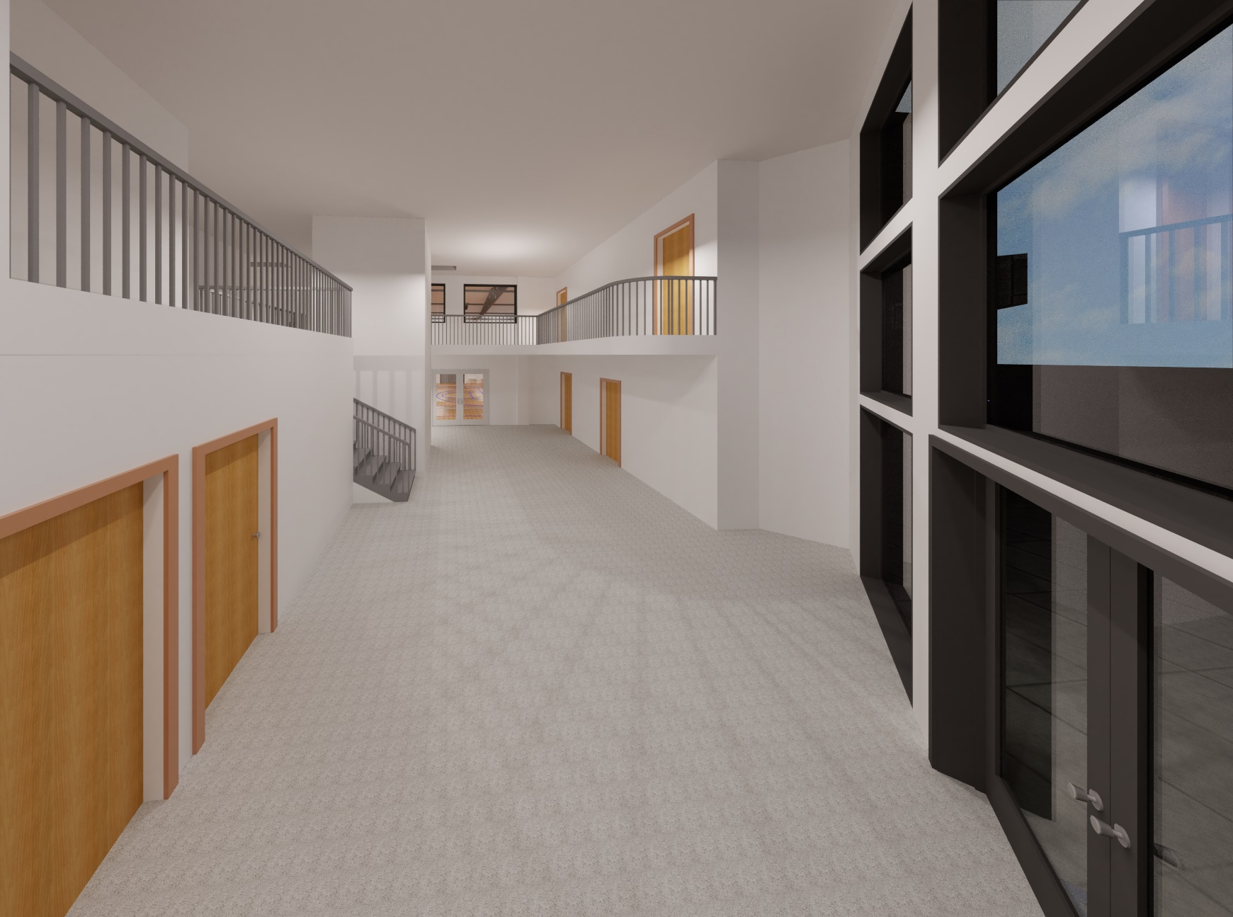
Recreation Center and Bathrooms
(Interior/Entry Way)

Slide 10
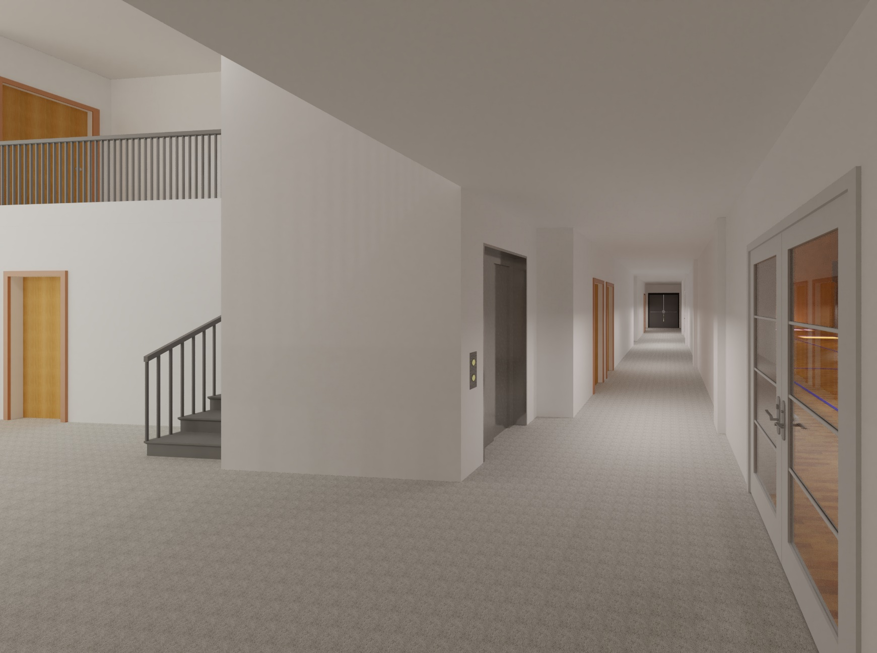
Recreation Center and Bathrooms
(Hallway)

Slide 11
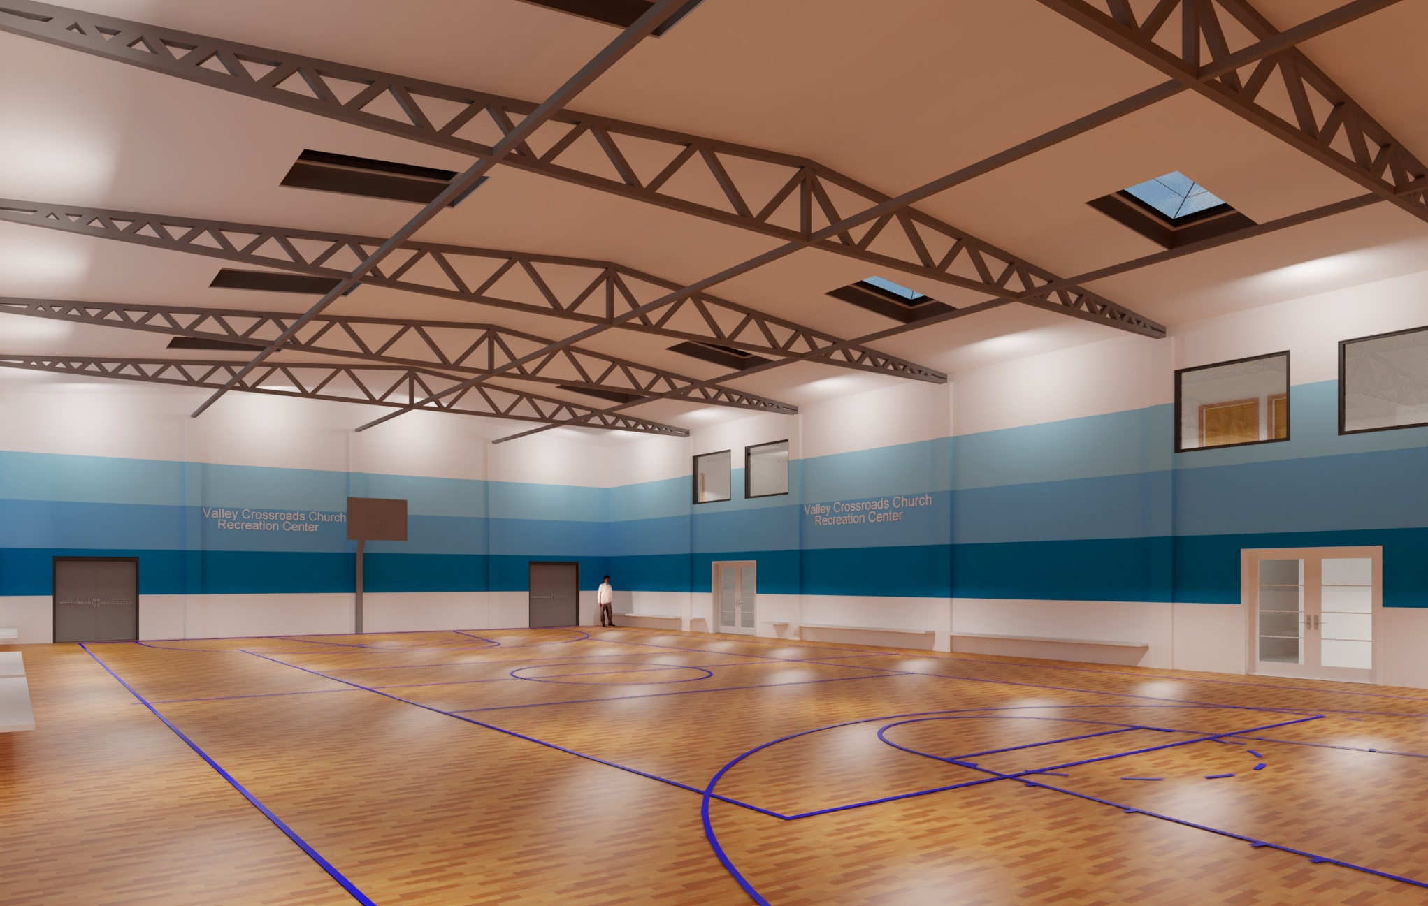
Recreation Center
(Interior)

Slide 12
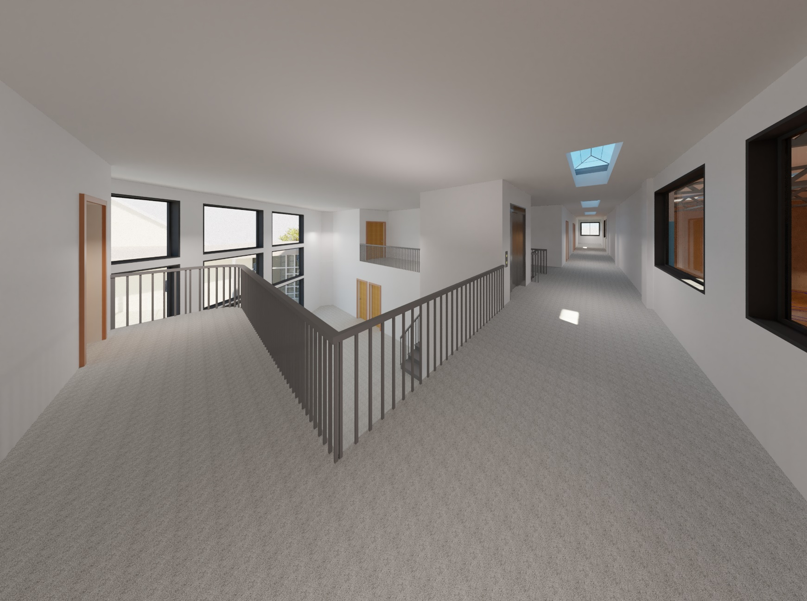
Recreation Center and Bathrooms
(Upper Hallway)

